Slide 1
Introduction to Differential Equations – Lecture 19
Fei Qi
fei.qi@du.edu
https://feiqimath.github.io

Slide 2
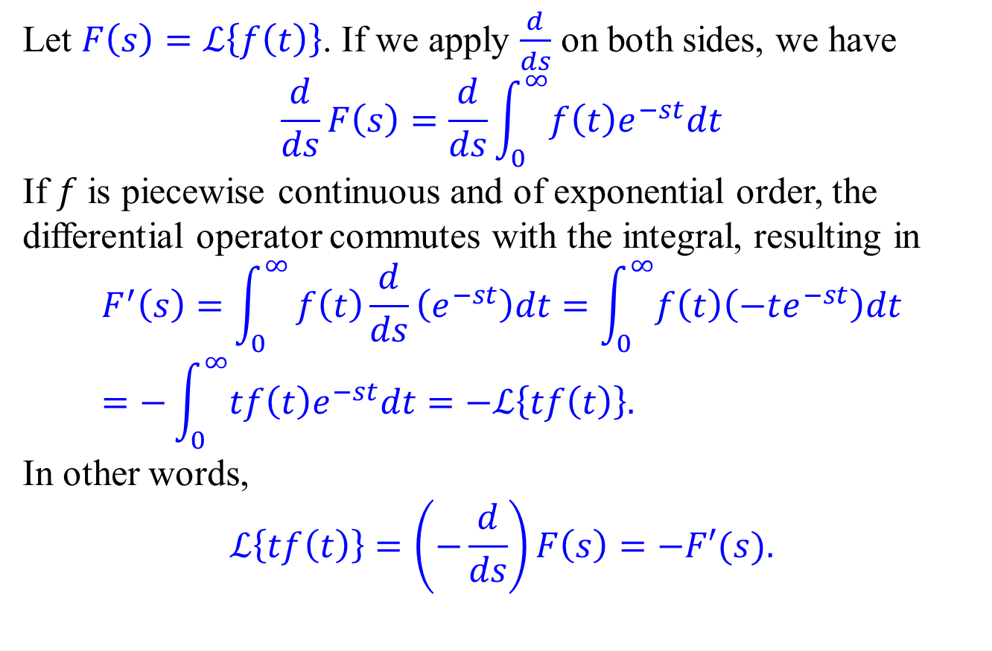

Derivatives of $ℒ\left\{f\left(t\right)\right\}$
Let $F\left(s\right)=ℒ\left\{f\left(t\right)\right\}$. If we apply $\frac{d}{ds}$ on both sides, we have
$$\frac{d}{ds}F\left(s\right)=\frac{d}{ds}\int_{0}^{∞}{f\left(t\right)e^{−st}dt}$$
If $f$ is piecewise continuous and of exponential order, the differential operator commutes with the integral, resulting in
$$F^{′}\left(s\right)=\int_{0}^{∞}{f\left(t\right)\frac{d}{ds}\left(e^{−st}\right)dt}=\int_{0}^{∞}{f\left(t\right)\left(−te^{−st}\right)dt} \\ =−\int_{0}^{∞}{tf\left(t\right)e^{−st}dt}=−ℒ\left\{tf\left(t\right)\right\}.$$
In other words,
$$ℒ\left\{tf\left(t\right)\right\}=\left(−\frac{d}{ds}\right)F\left(s\right)=−F′(s).$$

Slide 3
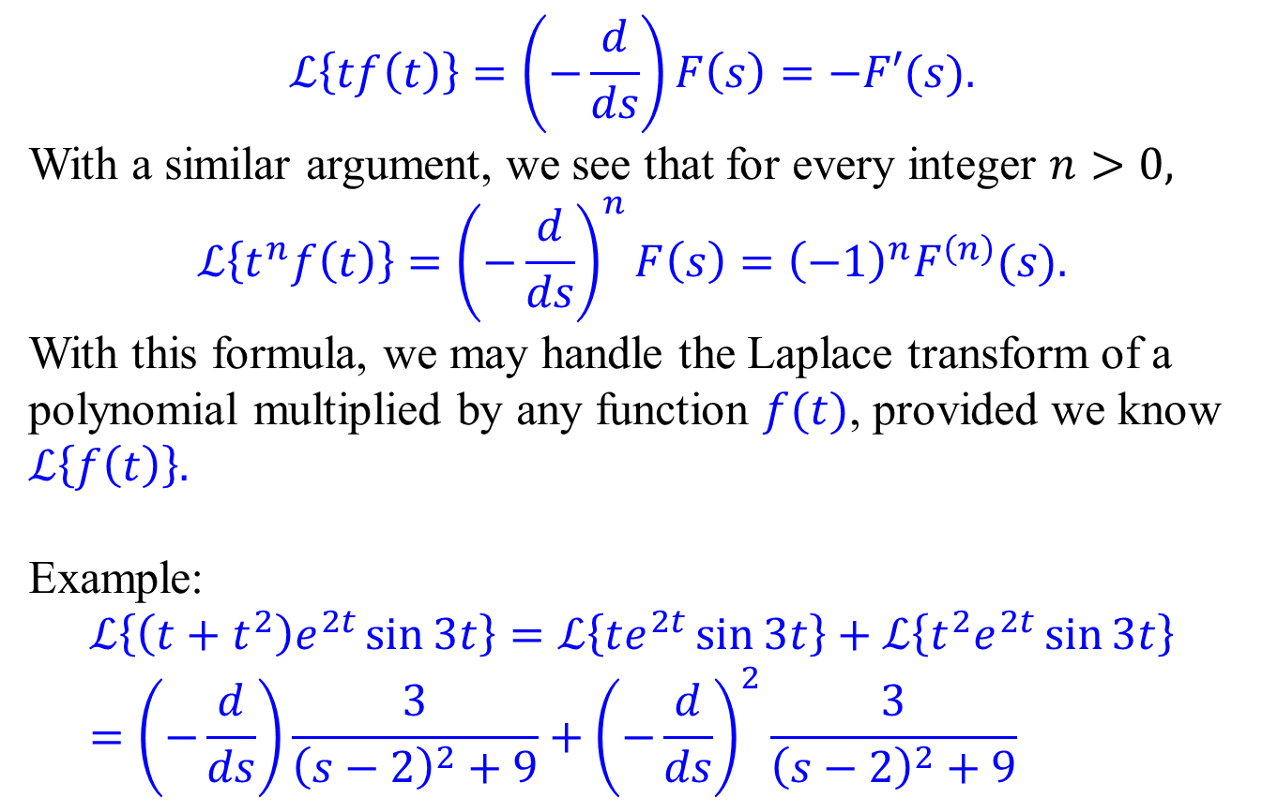
Derivatives of $ℒ\left\{f\left(t\right)\right\}$
$$ℒ\left\{tf\left(t\right)\right\}=\left(−\frac{d}{ds}\right)F\left(s\right)=−F′(s).$$
With a similar argument, we see that for every integer $n>0,$
$$ℒ\left\{t^{n}f\left(t\right)\right\}={\left(−\frac{d}{ds}\right)}^{n}F\left(s\right)={\left(−1\right)}^{n}F^{\left(n\right)}(s).$$
With this formula, we may handle the Laplace transform of a polynomial multiplied by any function $f(t)$, provided we know $ℒ\left\{f\left(t\right)\right\}.$
Example:
$$ℒ\left\{\left(t+t^{2}\right)e^{2t}\sin{3t}\right\}=ℒ\left\{te^{2t}\sin{3t}\right\}+ℒ\left\{t^{2}e^{2t}\sin{3t}\right\} \\ =\left(−\frac{d}{ds}\right)\frac{3}{{\left(s−2\right)}^{2}+9}+{\left(−\frac{d}{ds}\right)}^{2}\frac{3}{{\left(s−2\right)}^{2}+9}$$

Slide 4
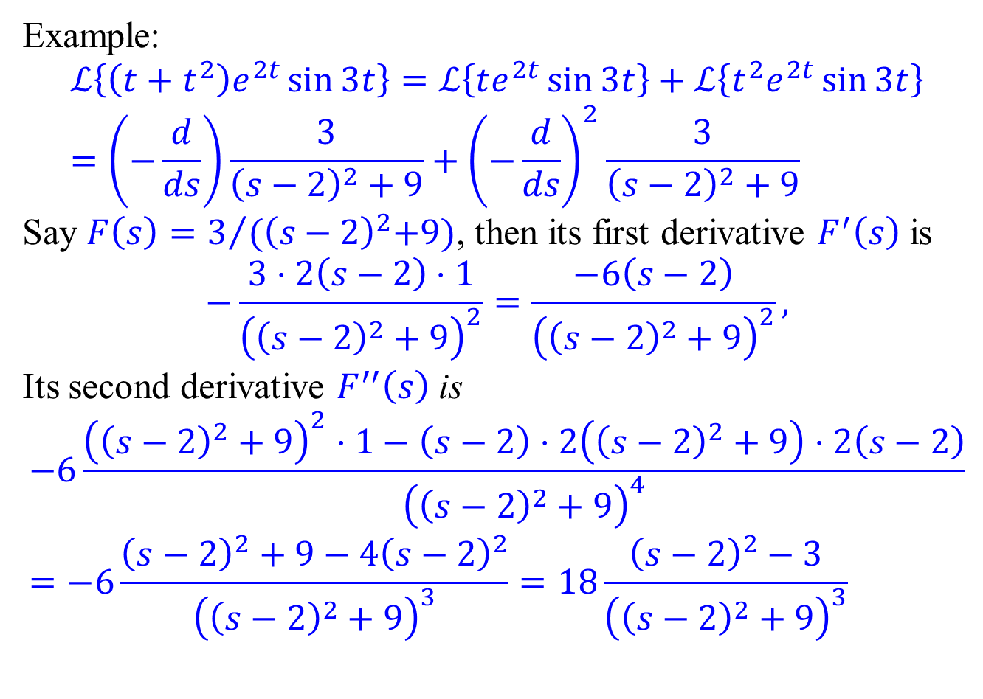
Laplace of products of all three kinds
Example:
$$ℒ\left\{\left(t+t^{2}\right)e^{2t}\sin{3t}\right\}=ℒ\left\{te^{2t}\sin{3t}\right\}+ℒ\left\{t^{2}e^{2t}\sin{3t}\right\} \\ =\left(−\frac{d}{ds}\right)\frac{3}{{\left(s−2\right)}^{2}+9}+{\left(−\frac{d}{ds}\right)}^{2}\frac{3}{{\left(s−2\right)}^{2}+9}$$
Say $F\left(s\right)=3/{{(\left(s−2\right)}^{2}+9)}$, then its first derivative $F^{′}\left(s\right)$ is
$$−\frac{3⋅2\left(s−2\right)⋅1}{{\left({\left(s−2\right)}^{2}+9\right)}^{2}}=\frac{−6\left(s−2\right)}{{\left({\left(s−2\right)}^{2}+9\right)}^{2}},$$
Its second derivative $F^{′′}\left(s\right)$ is $$−6\frac{{\left({\left(s−2\right)}^{2}+9\right)}^{2}⋅1−\left(s−2\right)⋅2\left({\left(s−2\right)}^{2}+9\right)⋅2\left(s−2\right)}{{\left({\left(s−2\right)}^{2}+9\right)}^{4}} \\ =−6\frac{{\left(s−2\right)}^{2}+9−4{\left(s−2\right)}^{2}}{{\left({\left(s−2\right)}^{2}+9\right)}^{3}}=18\frac{{\left(s−2\right)}^{2}−3}{{\left({\left(s−2\right)}^{2}+9\right)}^{3}}$$

Slide 5
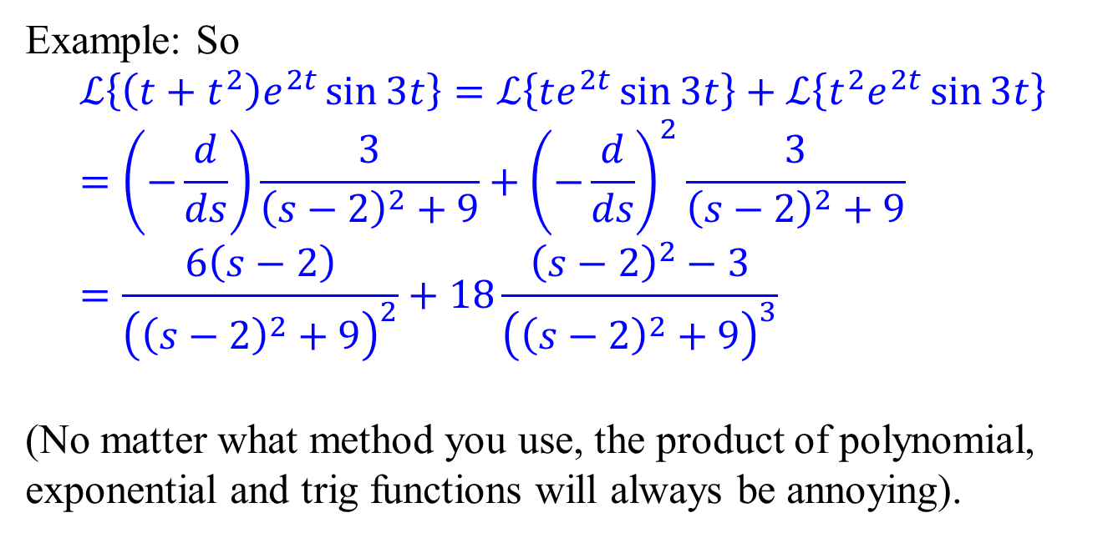
Laplace of products of all three kinds
Example: So
$$ℒ\left\{\left(t+t^{2}\right)e^{2t}\sin{3t}\right\}=ℒ\left\{te^{2t}\sin{3t}\right\}+ℒ\left\{t^{2}e^{2t}\sin{3t}\right\} \\ =\left(−\frac{d}{ds}\right)\frac{3}{{\left(s−2\right)}^{2}+9}+{\left(−\frac{d}{ds}\right)}^{2}\frac{3}{{\left(s−2\right)}^{2}+9} \\ =\frac{6\left(s−2\right)}{{\left({\left(s−2\right)}^{2}+9\right)}^{2}}+18\frac{{\left(s−2\right)}^{2}−3}{{\left({\left(s−2\right)}^{2}+9\right)}^{3}}$$
(No matter what method you use, the product of polynomial, exponential and trig functions will always be annoying).

Slide 6
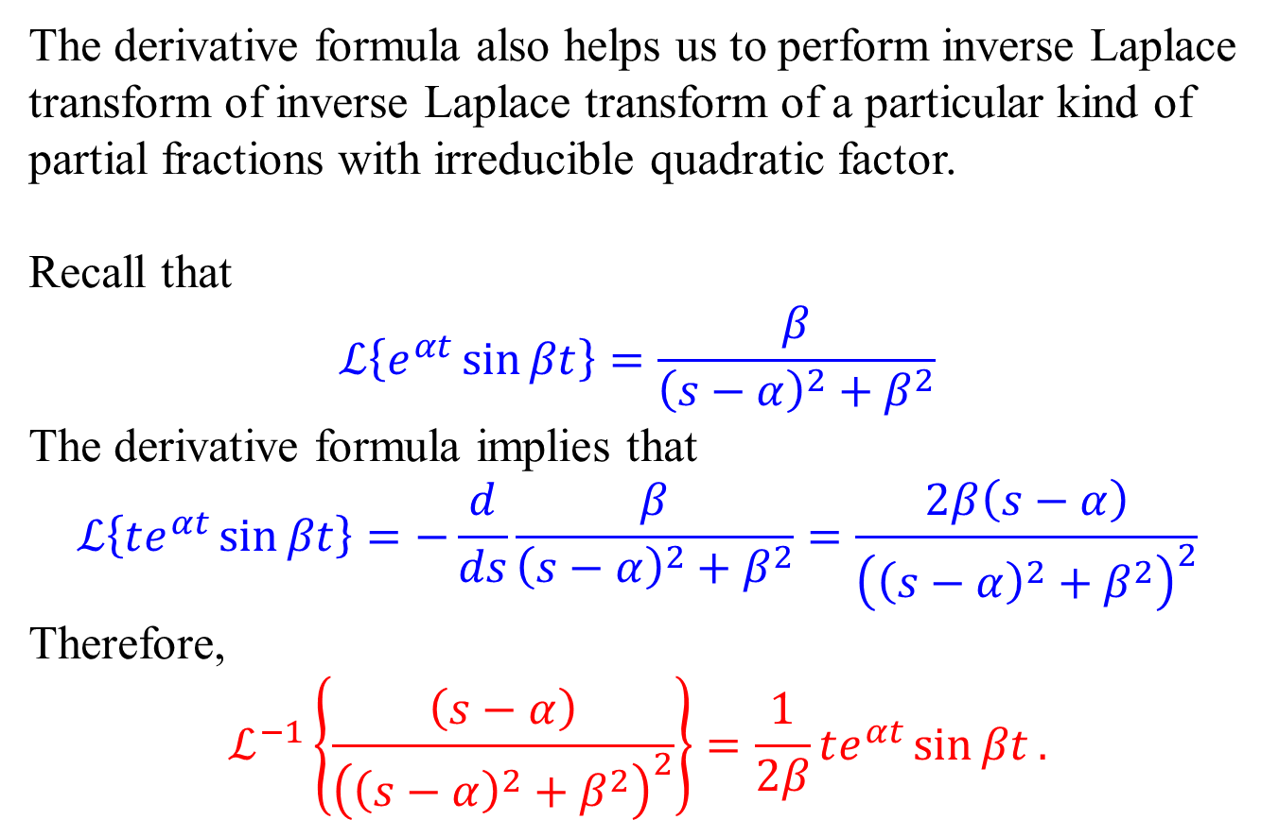
Inverse Laplace of repeated quadratic
The derivative formula also helps us to perform inverse Laplace transform of inverse Laplace transform of a particular kind of partial fractions with irreducible quadratic factor.
Recall that
$$ℒ\left\{e^{αt}\sin{βt}\right\}=\frac{β}{{\left(s−α\right)}^{2}+β^{2}}$$
The derivative formula implies that
$$ℒ\left\{te^{αt}\sin{βt}\right\}=−\frac{d}{ds}\frac{β}{{\left(s−α\right)}^{2}+β^{2}}=\frac{2β\left(s−α\right)}{{\left({\left(s−α\right)}^{2}+β^{2}\right)}^{2}}$$
Therefore,
$$ℒ^{−1}\left\{\frac{\left(s−α\right)}{{\left({\left(s−α\right)}^{2}+β^{2}\right)}^{2}}\right\}=\frac{1}{2β}te^{αt}\sin{βt}.$$

Slide 7
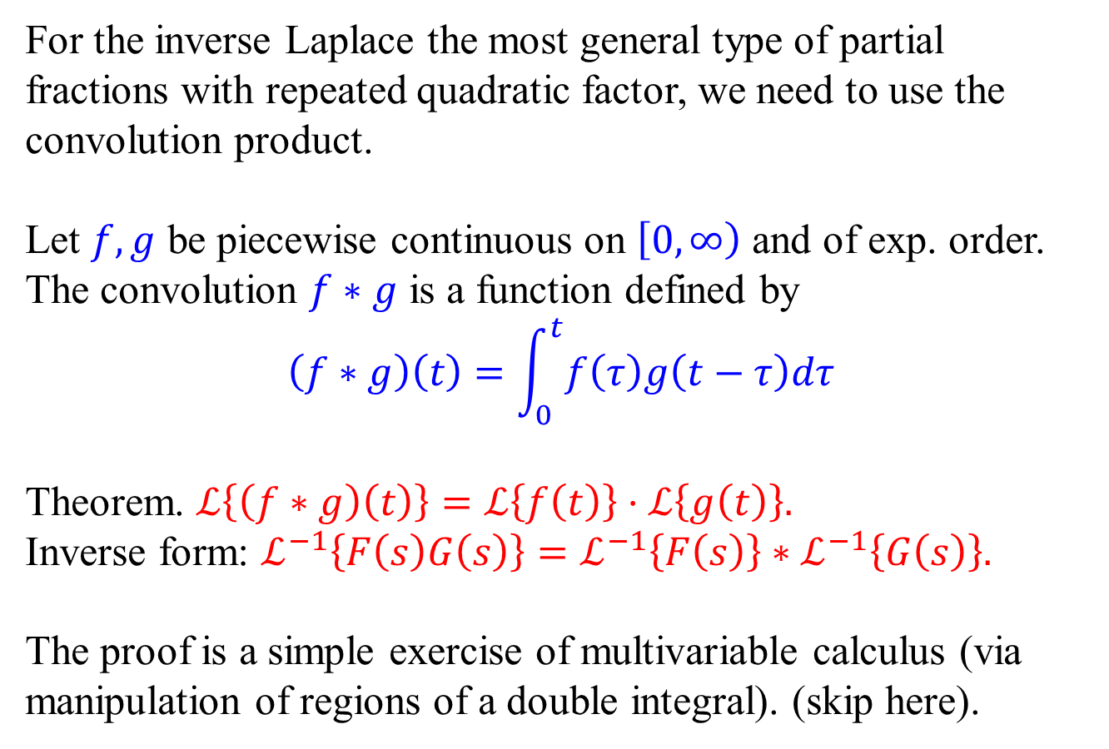
Convolution product
For the inverse Laplace the most general type of partial fractions with repeated quadratic factor, we need to use the convolution product.
Let $f,g$ be piecewise continuous on $\left[0, ∞\right)$ and of exp. order.
The convolution $f∗g$ is a function defined by
$$\left(f∗g\right)\left(t\right)=\int_{0}^{t}{f\left(τ\right)g\left(t−τ\right)dτ}$$
Theorem. $ℒ\left\{\left(f∗g\right)\left(t\right)\right\}=ℒ\left\{f\left(t\right)\right\}⋅ℒ\left\{g\left(t\right)\right\}.$
Inverse form: $ℒ^{−1}\left\{F\left(s\right)G\left(s\right)\right\}=ℒ^{−1}\left\{F\left(s\right)\right\}∗ℒ^{−1}\left\{G\left(s\right)\right\}.$
The proof is a simple exercise of multivariable calculus (via manipulation of regions of a double integral). (skip here).

Slide 8
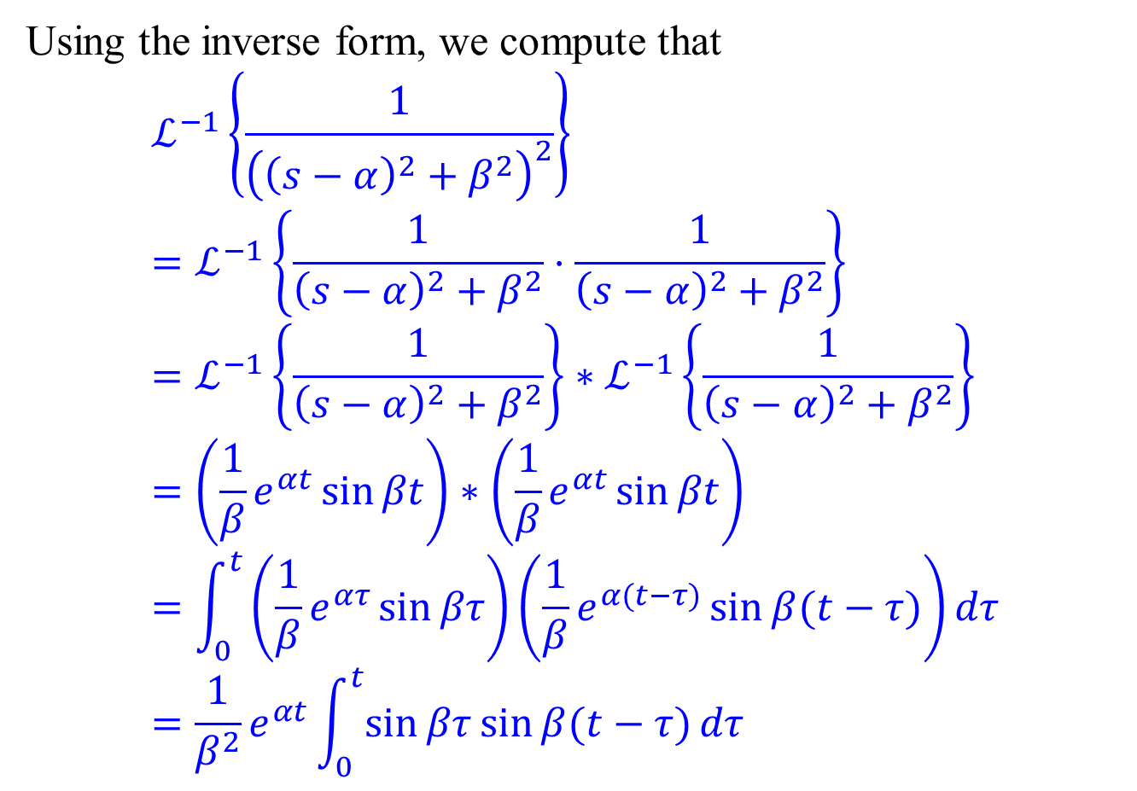
Convolution product
Using the inverse form, we compute that
$$ℒ^{−1}\left\{\frac{1}{{\left({\left(s−α\right)}^{2}+β^{2}\right)}^{2}}\right\}=ℒ^{−1}\left\{\frac{1}{{\left(s−α\right)}^{2}+β^{2}}⋅\frac{1}{{\left(s−α\right)}^{2}+β^{2}}\right\} \\ =ℒ^{−1}\left\{\frac{1}{{\left(s−α\right)}^{2}+β^{2}}\right\}∗ℒ^{−1}\left\{\frac{1}{{\left(s−α\right)}^{2}+β^{2}}\right\} \\ =\left(\frac{1}{β}e^{αt}\sin{βt}\right)∗\left(\frac{1}{β}e^{αt}\sin{βt}\right) \\ =\int_{0}^{t}{\left(\frac{1}{β}e^{ατ}\sin{βτ}\right)\left(\frac{1}{β}e^{α(t−τ)}\sin{β(t−τ)}\right)dτ} \\ =\frac{1}{β^{2}}e^{αt}\int_{0}^{t}{\sin{βτ}\sin{β(t−τ)}dτ}$$

Slide 9
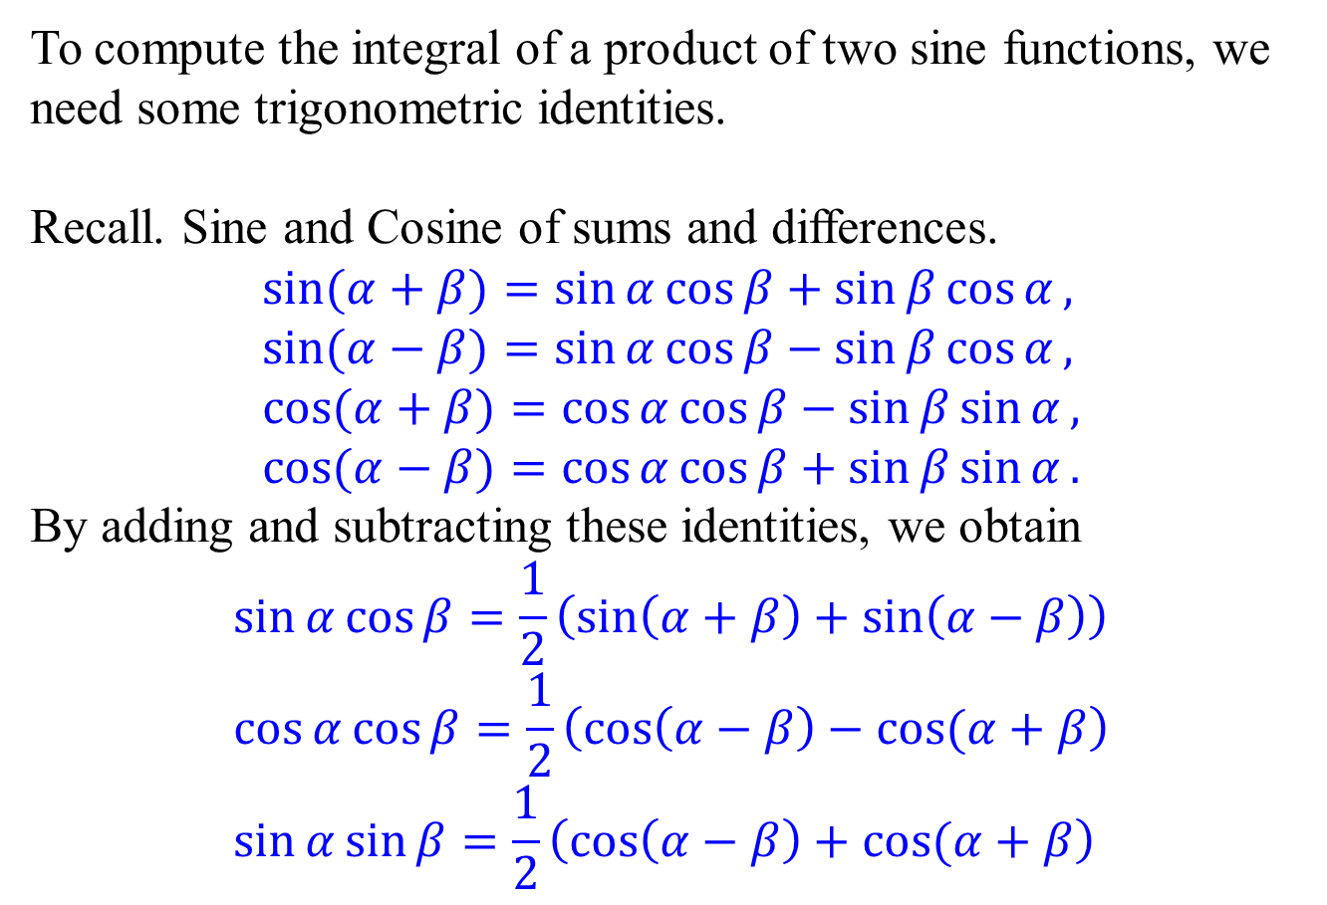
Convolution product
To compute the integral of a product of two sine functions, we need some trigonometric identities.
Recall. Sine and Cosine of sums and differences.
$$\sin{(α+β)}=\sin{α}\cos{β}+\sin{β}\cos{α}, \\ \sin{(α−β)}=\sin{α}\cos{β}−\sin{β}\cos{α}, \\ \cos{(α+β)}=\cos{α}\cos{β}−\sin{β}\sin{α}, \\ \cos{(α−β)}=\cos{α}\cos{β}+\sin{β}\sin{α}.$$
By adding and subtracting these identities, we obtain
$$\sin{α}\cos{β}=\frac{1}{2}\left(\sin\left(α+β\right)+\sin\left(α−β\right)\right) \\ \cos{α}\cos{β}=\frac{1}{2}\left(\cos\left(α−β\right)−\cos{(α+β}\right) \\ \sin{α}\sin{β}=\frac{1}{2}\left(\cos\left(α−β\right)+\cos{(α+β}\right)$$

Slide 10
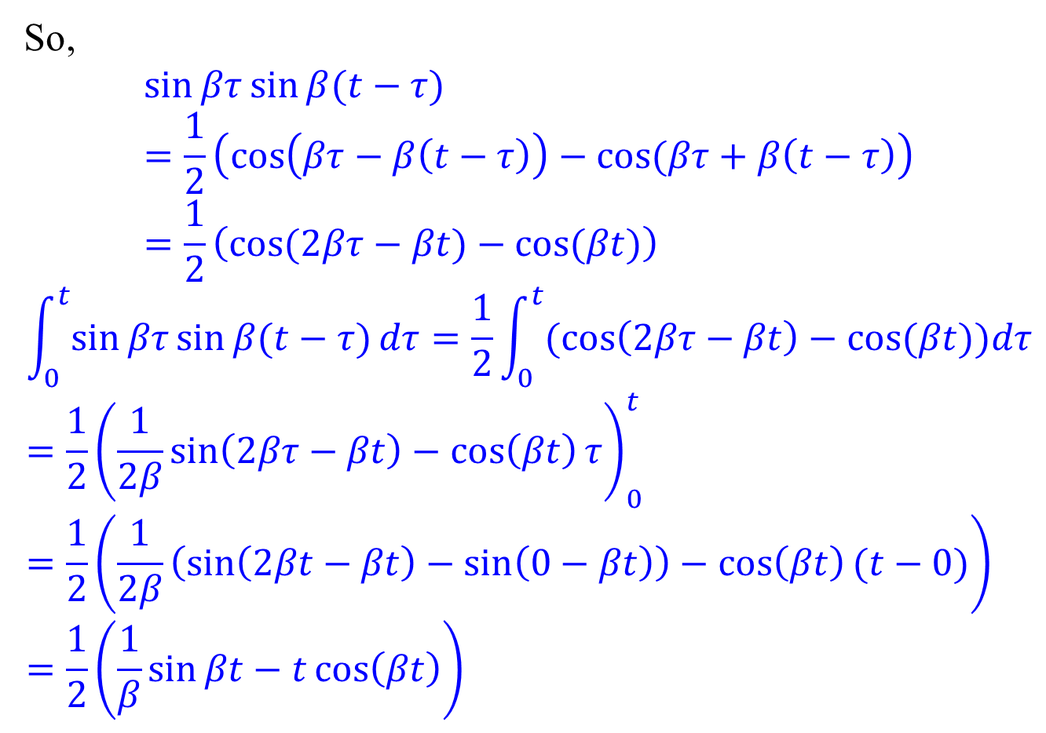
Convolution product
So,
$$\sin{βτ}\sin{β(t−τ)}=\frac{1}{2}\left(\cos\left(βτ−β\left(t−τ\right)\right)−\cos{(βτ+β\left(t−τ\right)}\right) \\ =\frac{1}{2}\left(\cos{(2βτ−βt)}−\cos{(βt})\right)$$
$$\int_{0}^{t}{\sin{βτ}\sin{β(t−τ)}dτ}=\frac{1}{2}\int_{0}^{t}{(\cos\left(2βτ−βt\right)−\cos{(βt}))dτ} \\ =\frac{1}{2}{\left(\frac{1}{2β}\sin\left(2βτ−βt\right)−\cos\left(βt\right)τ\right)}_{0}^{t} \\ =\frac{1}{2}\left(\frac{1}{2β}\left(\sin\left(2βt−βt\right)−\sin\left(0−βt\right)\right)−\cos\left(βt\right)(t−0)\right) \\ =\frac{1}{2}\left(\frac{1}{β}\sin{βt}−t\cos\left(βt\right)\right)$$

Slide 11
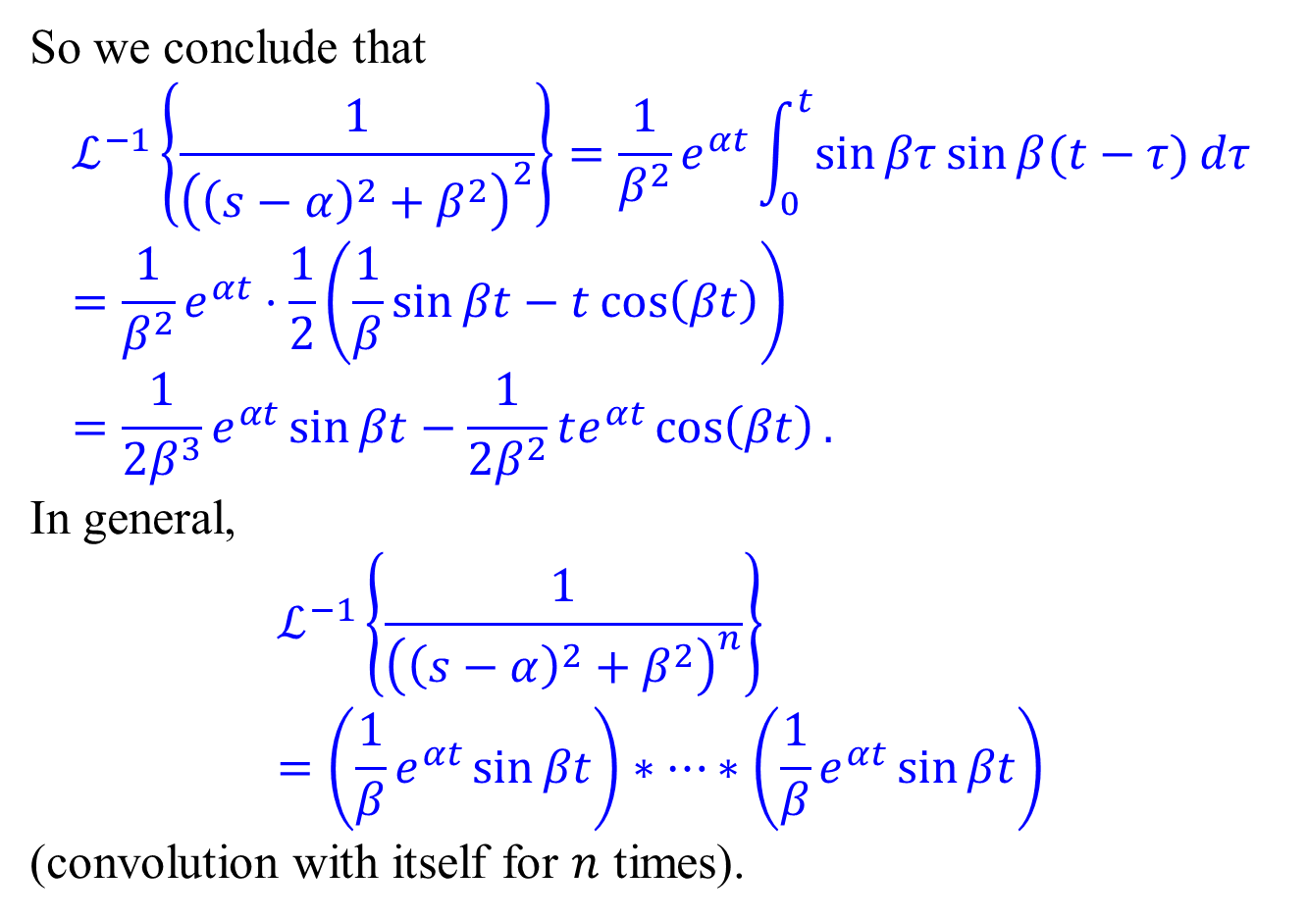
Convolution product
So we conclude that
$$ℒ^{−1}\left\{\frac{1}{{\left({\left(s−α\right)}^{2}+β^{2}\right)}^{2}}\right\}=\frac{1}{β^{2}}e^{αt}\int_{0}^{t}{\sin{βτ}\sin{β(t−τ)}dτ} \\ =\frac{1}{β^{2}}e^{αt}⋅\frac{1}{2}\left(\frac{1}{β}\sin{βt}−t\cos\left(βt\right)\right) \\ =\frac{1}{2β^{3}}e^{αt}\sin{βt}−\frac{1}{2β^{2}}te^{αt}\cos\left(βt\right).$$
In general,
$$ℒ^{−1}\left\{\frac{1}{{\left({\left(s−α\right)}^{2}+β^{2}\right)}^{n}}\right\}=\left(\frac{1}{β}e^{αt}\sin{βt}\right)∗⋯∗\left(\frac{1}{β}e^{αt}\sin{βt}\right)$$
(convolution with itself for $n$ times).

Slide 12
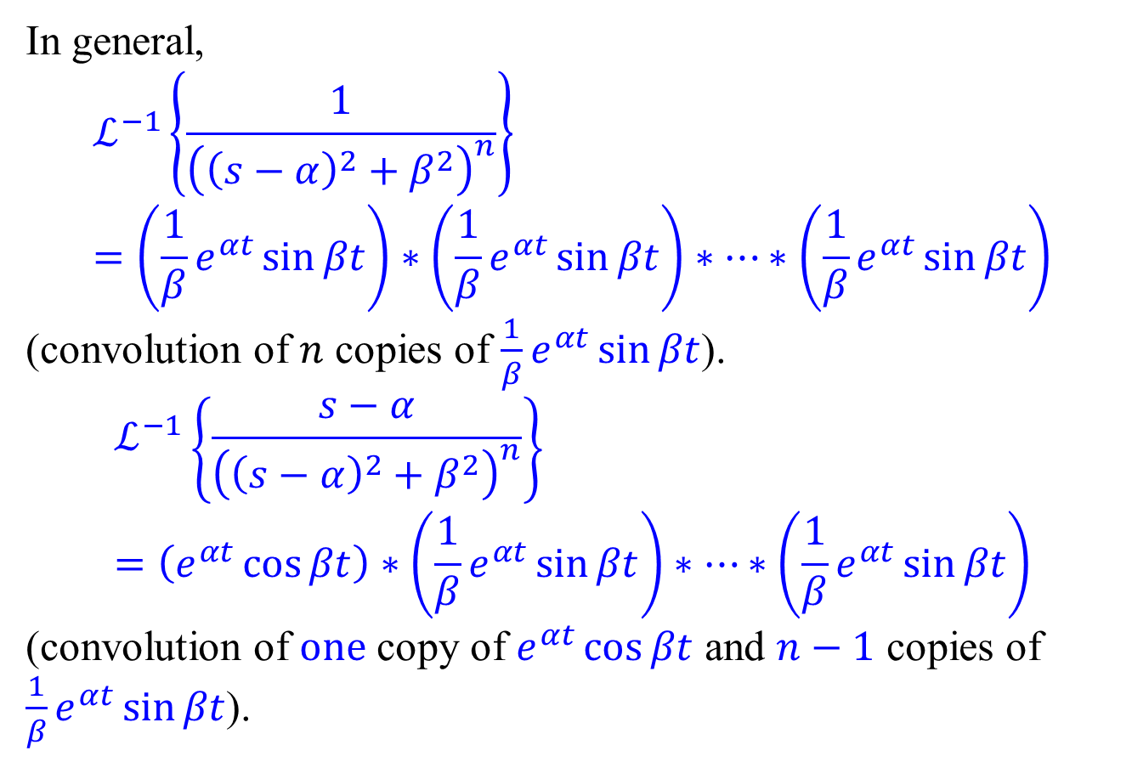
Convolution product
In general,
$$ℒ^{−1}\left\{\frac{1}{{\left({\left(s−α\right)}^{2}+β^{2}\right)}^{n}}\right\}=\left(\frac{1}{β}e^{αt}\sin{βt}\right)∗\left(\frac{1}{β}e^{αt}\sin{βt}\right)∗⋯∗\left(\frac{1}{β}e^{αt}\sin{βt}\right)$$
(convolution of $n$ copies of $\frac{1}{β}e^{αt}\sin{βt}$).
$$ℒ^{−1}\left\{\frac{s−α}{{\left({\left(s−α\right)}^{2}+β^{2}\right)}^{n}}\right\} \\ =\left(e^{αt}\cos{βt}\right)∗\left(\frac{1}{β}e^{αt}\sin{βt}\right)∗⋯∗\left(\frac{1}{β}e^{αt}\sin{βt}\right)$$
(convolution of one copy of $e^{αt}\cos{βt}$ and $n−1$ copies of $\frac{1}{β}e^{αt}\sin{βt}$).

Slide 13
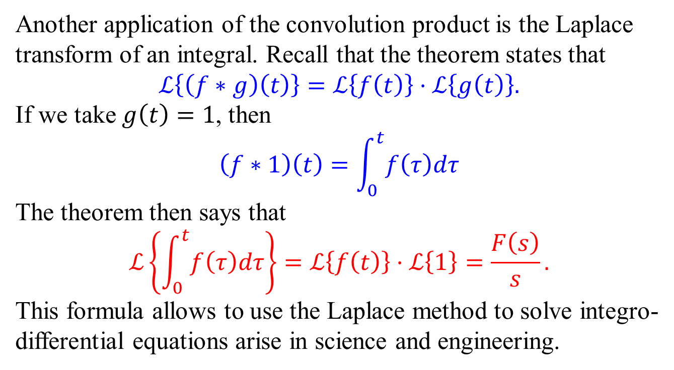
Integro-differential equation
Another application of the convolution product is the Laplace transform of an integral. Recall that the theorem states that
$$ℒ\left\{\left(f∗g\right)\left(t\right)\right\}=ℒ\left\{f\left(t\right)\right\}⋅ℒ\left\{g\left(t\right)\right\}.$$
If we take $g\left(t\right)=1$, then
$$\left(f∗1\right)\left(t\right)=\int_{0}^{t}{f\left(τ\right)dτ}$$
The theorem then says that
$$ℒ\left\{\int_{0}^{t}{f\left(τ\right)dτ}\right\}=ℒ\left\{f\left(t\right)\right\}⋅ℒ\left\{1\right\}=\frac{F\left(s\right)}{s}.$$
This formula allows to use the Laplace method to solve integro-differential equations arise in science and engineering.

Slide 14
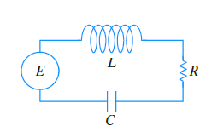
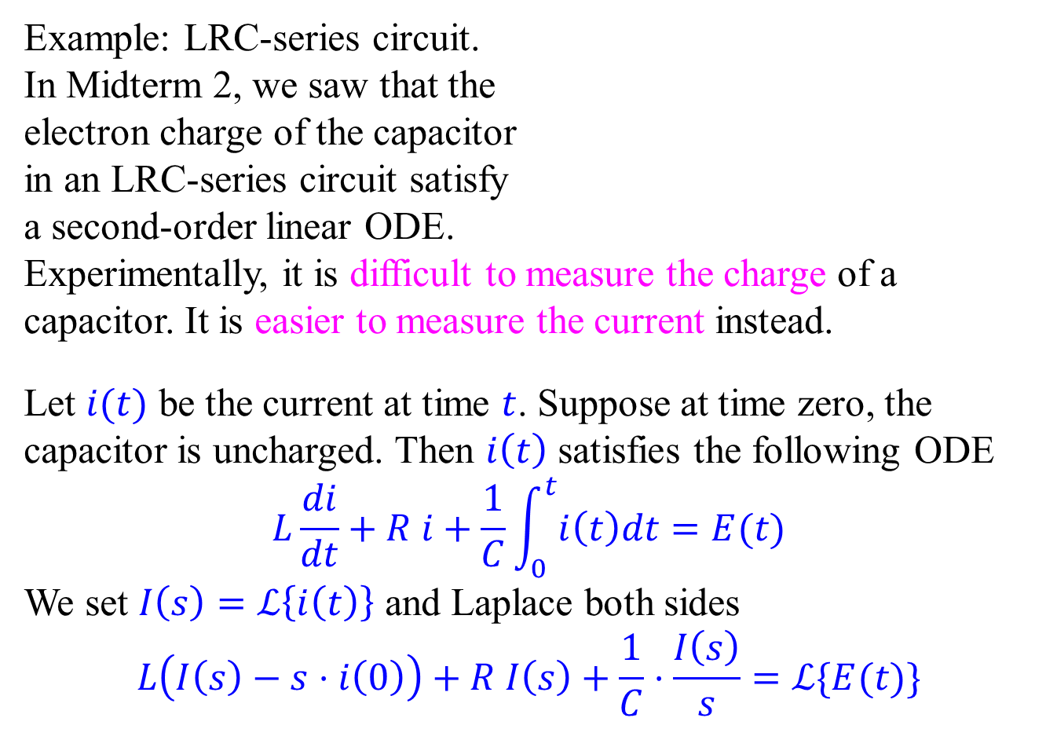
Integro-differential equation
Example: LRC-series circuit.
In Midterm 2, we saw that the electron charge of the capacitor in an LRC-series circuit satisfy a second-order linear ODE.
Experimentally, it is difficult to measure the charge of a capacitor. It is easier to measure the current instead.
Let $i(t)$ be the current at time $t$. Suppose at time zero, the capacitor is uncharged. Then $i\left(t\right)$ satisfies the following ODE
$$L\frac{di}{dt}+R i+\frac{1}{C}\int_{0}^{t}{i\left(t\right)dt}=E(t)$$
We set $I\left(s\right)=ℒ\left\{i\left(t\right)\right\}$ and Laplace both sides
$$L\left(I\left(s\right)−s⋅i\left(0\right)\right)+R I\left(s\right)+\frac{1}{C}⋅\frac{I\left(s\right)}{s}=ℒ\{E(t)\}$$

Slide 15
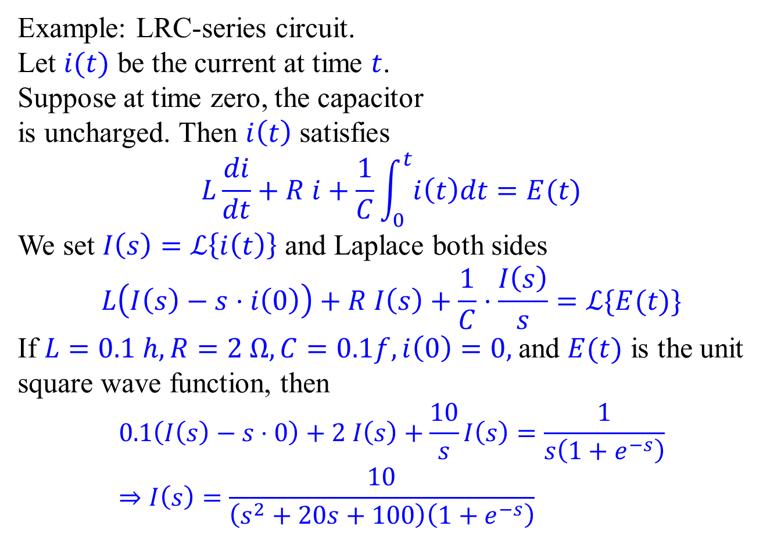
Integro-differential equation
Example: LRC-series circuit.
Let $i(t)$ be the current at time $t$. Suppose at time zero, the capacitor is uncharged. Then $i\left(t\right)$ satisfies
$$L\frac{di}{dt}+R i+\frac{1}{C}\int_{0}^{t}{i\left(t\right)dt}=E(t)$$
We set $I\left(s\right)=ℒ\left\{i\left(t\right)\right\}$ and Laplace both sides
$$L\left(I\left(s\right)−s⋅i\left(0\right)\right)+R I\left(s\right)+\frac{1}{C}⋅\frac{I\left(s\right)}{s}=ℒ\{E(t)\}$$
If $L=0.1 h, R=2 Ω, C=0.1f, i\left(0\right)=0,$and $E(t)$ is the unit square wave function, then
$$0.1\left(I\left(s\right)−s⋅0\right)+2 I\left(s\right)+\frac{10}{s}I\left(s\right)=\frac{1}{s\left(1+e^{−s}\right)} \\ ⇒I\left(s\right)=\frac{10}{\left(s^{2}+20s+100\right)\left(1+e^{−s}\right)}$$

Slide 16
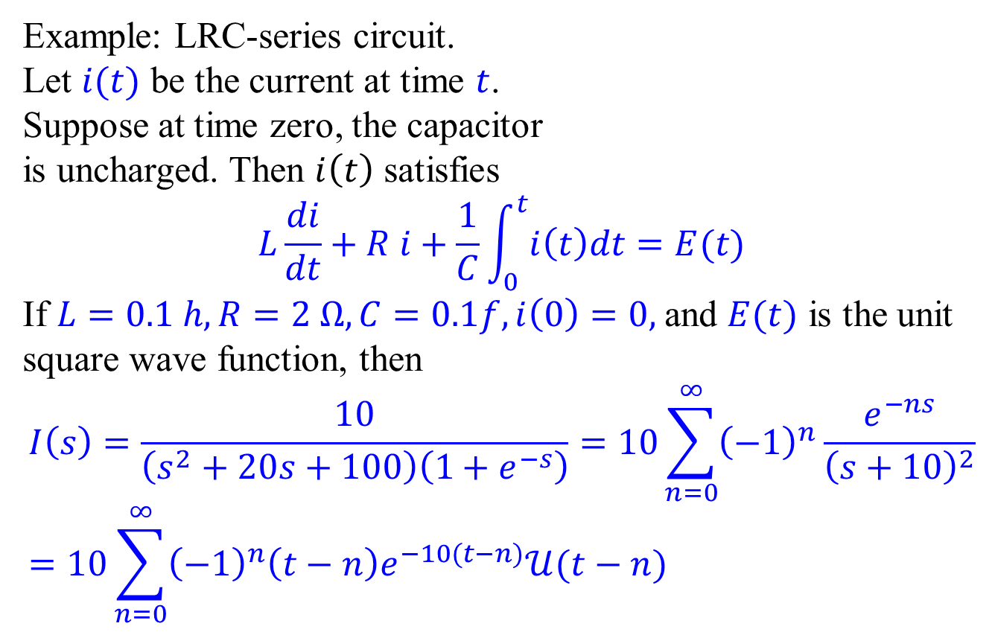
Integro-differential equation
Example: LRC-series circuit.
Let $i(t)$ be the current at time $t$. Suppose at time zero, the capacitor is uncharged. Then $i\left(t\right)$ satisfies
$$L\frac{di}{dt}+R i+\frac{1}{C}\int_{0}^{t}{i\left(t\right)dt}=E(t)$$
If $L=0.1 h, R=2 Ω, C=0.1f, i\left(0\right)=0,$and $E(t)$ is the unit square wave function, then
$$I\left(s\right)=\frac{10}{\left(s^{2}+20s+100\right)\left(1+e^{−s}\right)}=10\sum_{n=0}^{∞}{{\left(−1\right)}^{n}\frac{e^{−ns}}{{\left(s+10\right)}^{2}}}=10\sum_{n=0}^{∞}{{\left(−1\right)}^{n}\left(t−n\right)e^{−10(t−n)}𝒰(t−n)}$$

Slide 17
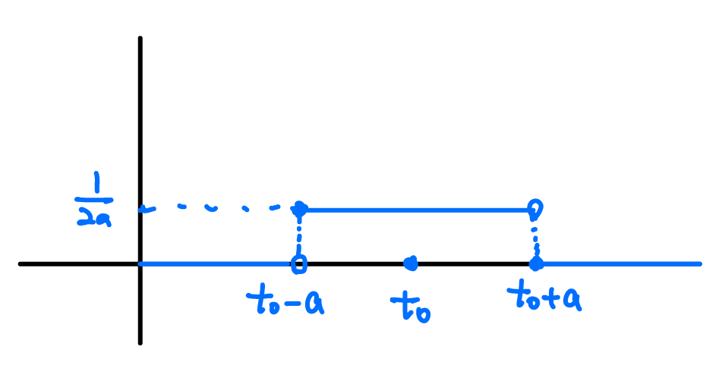


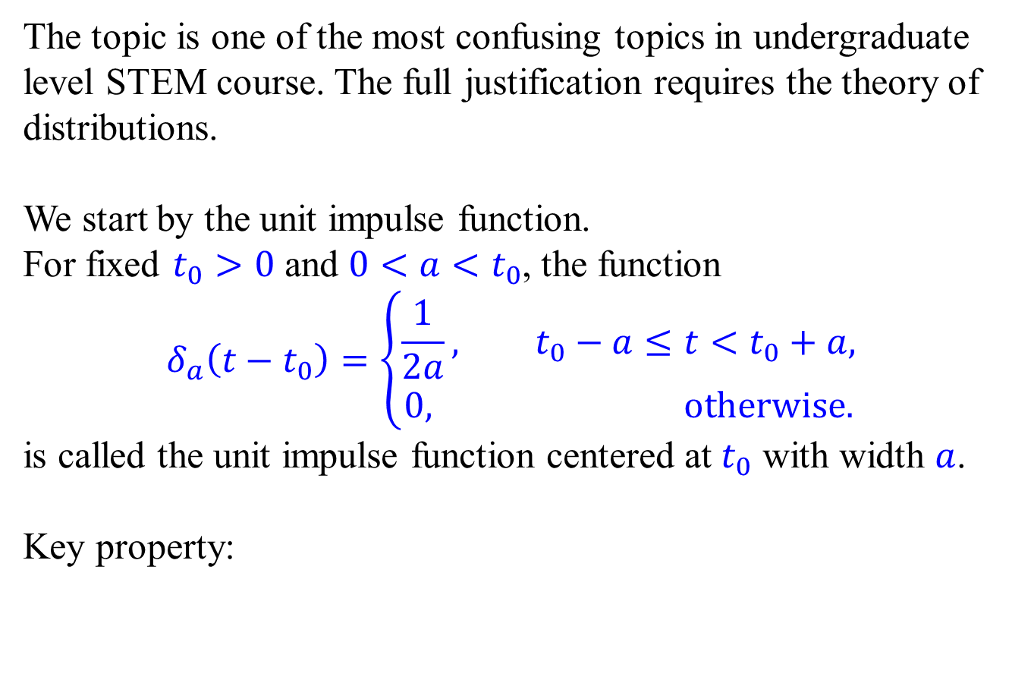
Dirac $δ$-function
The topic is one of the most confusing topics in undergraduate level STEM course. The full justification requires the theory of distributions.
We start by the unit impulse function.
For fixed $t_{0}>0$ and $0<a<t_{0}$, the function
$$δ_{a}\left(t−t_{0}\right)=\left\{\begin{aligned}\frac{1}{2a}, t_{0}−a≤t<t_{0}+a, \\ 0, otherwise.\end{aligned}\right.$$ is called the unit impulse function centered at $t_{0}$ with width $a$.
Key property:
$$\int_{0}^{∞}{δ_{a}\left(t−t_{0}\right)dt=1}$$

Slide 18
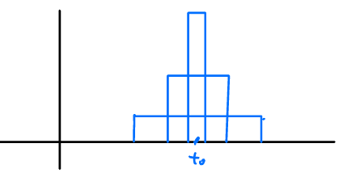



Dirac $δ$-function
For fixed $t_{0}>0$ and $0<a<t_{0}$, the function
$$δ_{a}\left(t−t_{0}\right)=\left\{\begin{aligned}\frac{1}{2a}, t_{0}−a≤t<t_{0}+a, \\ 0, otherwise.\end{aligned}\right.$$ is called the unit impulse function centered at $t_{0}$ with width $a$.
Key property:
The Dirac $δ$-function is defined
as the “limit” of the unit impulse
function
$$\int_{0}^{∞}{δ_{a}\left(t−t_{0}\right)dt=1}$$
$$δ\left(t−t_{0}\right)=``{\lim_{a→0}}^{′′}δ_{a}\left(t−t_{0}\right)$$

Slide 19
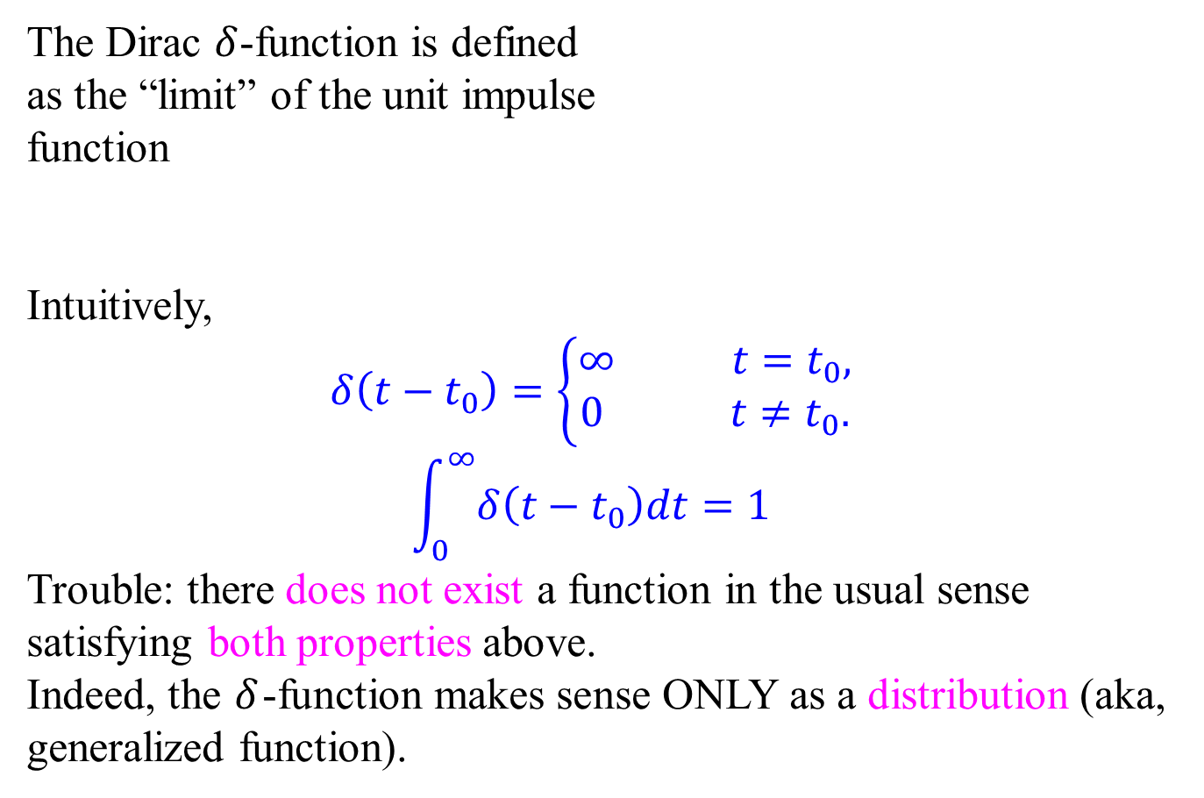

Dirac $δ$-function
The Dirac $δ$-function is defined
as the “limit” of the unit impulse
function
Intuitively,
$$δ\left(t−t_{0}\right)=\left\{\begin{aligned}∞ t=t_{0}, \\ 0 t≠t_{0}.\end{aligned}\right.$$
$$\int_{0}^{∞}{δ\left(t−t_{0}\right)dt}=1$$
Trouble: there does not exist a function in the usual sense satisfying both properties above.
Indeed, the $δ$-function makes sense ONLY as a distribution (aka, generalized function).
$$δ\left(t−t_{0}\right)=``{\lim_{a→0}}^{′′}δ_{a}\left(t−t_{0}\right)$$

Slide 20
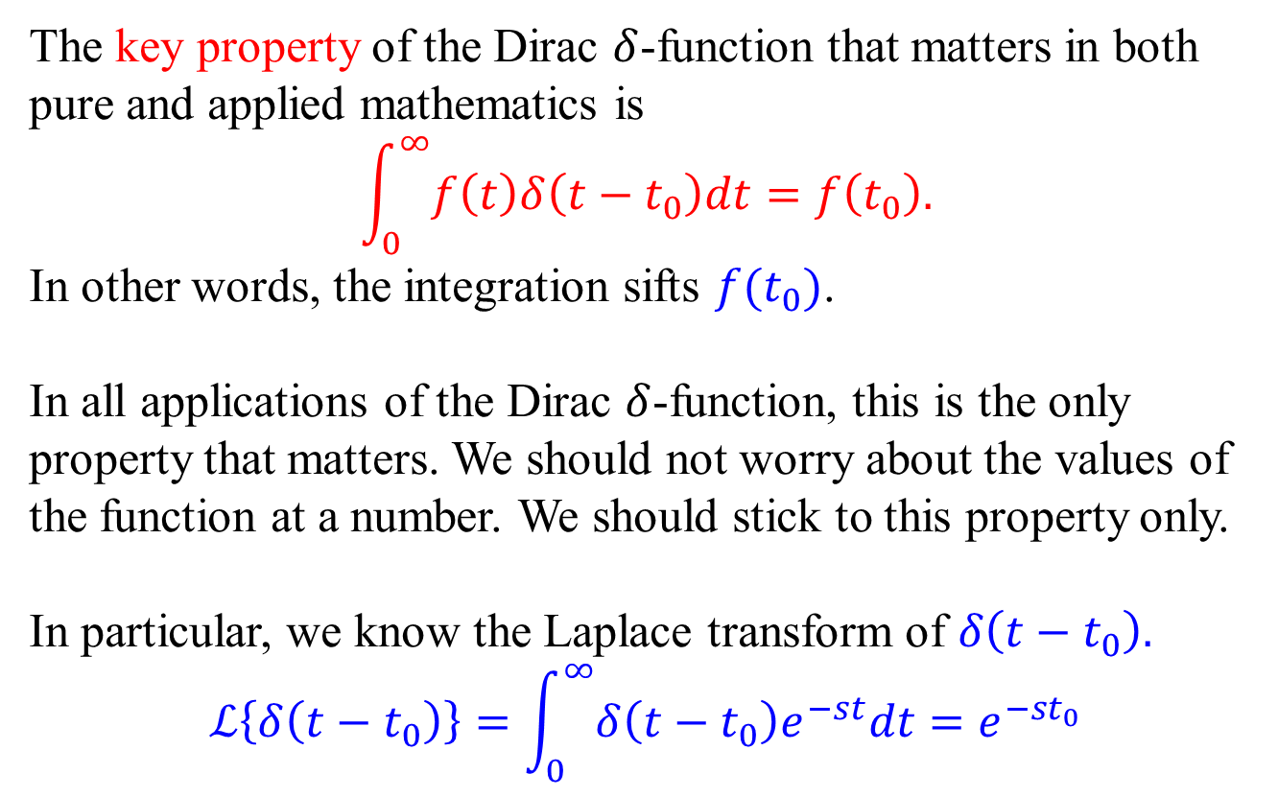
Dirac $δ$-function
The key property of the Dirac $δ$-function that matters in both pure and applied mathematics is
$$\int_{0}^{∞}{f\left(t\right)δ\left(t−t_{0}\right)dt}=f\left(t_{0}\right).$$
In other words, the integration sifts $f(t_{0})$.
In all applications of the Dirac $δ$-function, this is the only property that matters. We should not worry about the values of the function at a number. We should stick to this property only.
In particular, we know the Laplace transform of $δ\left(t−t_{0}\right).$
$$ℒ\left\{δ\left(t−t_{0}\right)\right\}=\int_{0}^{∞}{δ\left(t−t_{0}\right)e^{−st}dt}=e^{−st_{0}}$$

Slide 21
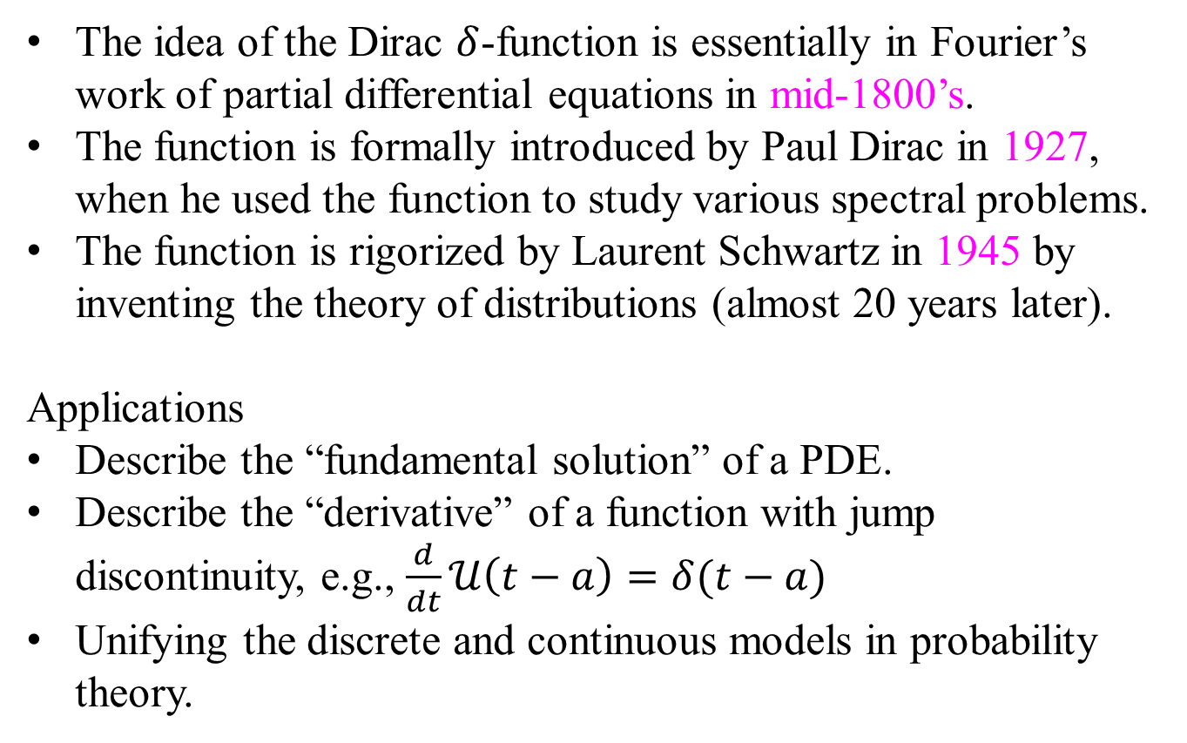

Dirac $δ$-function – history and applications
The idea of the Dirac $δ$-function is essentially in Fourier’s work of partial differential equations in mid-1800’s.
The function is formally introduced by Paul Dirac in 1927, when he used the function to study various spectral problems.
The function is rigorized by Laurent Schwartz in 1945 by inventing the theory of distributions (almost 20 years later).
Applications
Describe the “fundamental solution” of a PDE.
Describe the “derivative” of a function with jump discontinuity, e.g., $\frac{d}{dt}𝒰\left(t−a\right)=δ(t−a)$
Unifying the discrete and continuous models in probability theory.

Slide 22
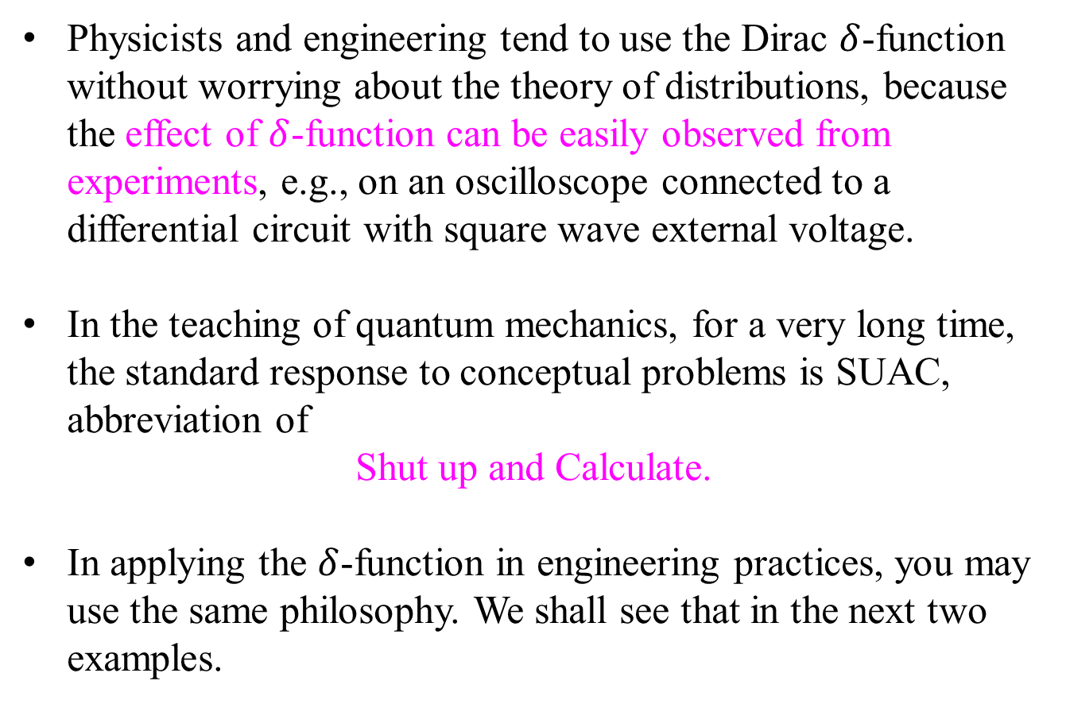
Dirac $δ$-function – history and applications
Physicists and engineering tend to use the Dirac $δ$-function without worrying about the theory of distributions, because the effect of $δ$-function can be easily observed from experiments, e.g., on an oscilloscope connected to a differential circuit with square wave external voltage.
In the teaching of quantum mechanics, for a very long time, the standard response to conceptual problems is SUAC, abbreviation of
Shut up and Calculate.
In applying the $δ$-function in engineering practices, you may use the same philosophy. We shall see that in the next two examples.

Slide 23
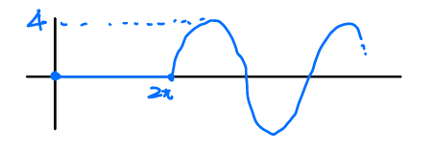
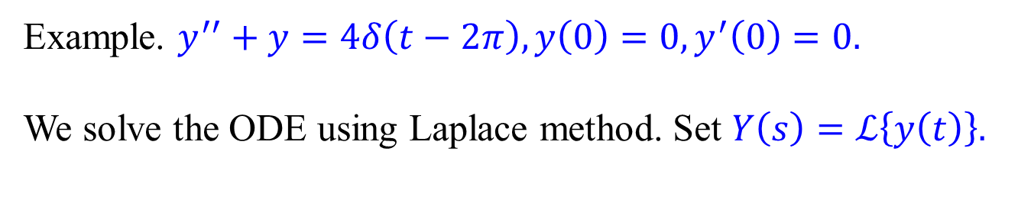
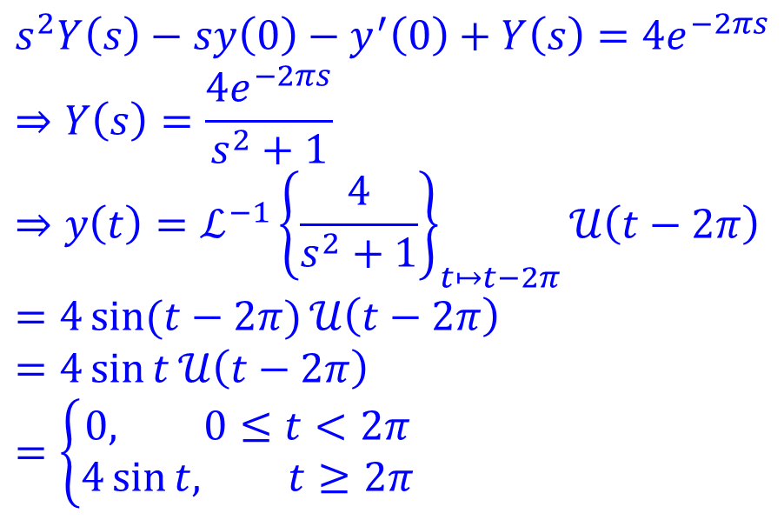

Dirac $δ$-function – examples
Example. $y^{′′}+y=4δ\left(t−2π\right), y\left(0\right)=0,y^{′}\left(0\right)=0.$
We solve the ODE using Laplace method. Set $Y\left(s\right)=ℒ\left\{y\left(t\right)\right\}.$
$$s^{2}Y\left(s\right)−sy\left(0\right)−y^{′}\left(0\right)+Y\left(s\right)=4e^{−2πs} \\ ⇒Y\left(s\right)=\frac{4e^{−2πs}}{s^{2}+1} \\ ⇒y\left(t\right)=ℒ^{−1}{\left\{\frac{4}{s^{2}+1}\right\}}_{t↦t−2π}𝒰\left(t−2π\right) \\ =4\sin{(t−2π)}𝒰\left(t−2π\right) \\ =4\sin{t}𝒰\left(t−2π\right) \\ =\left\{\begin{aligned}0, 0≤t<2π \\ 4\sin{t, t≥2π}\end{aligned}\right.$$

Slide 24
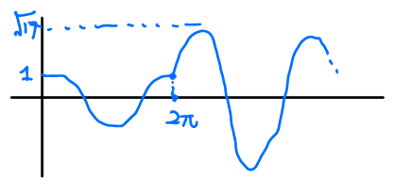


Dirac $δ$-function – examples
Example. $y^{′′}+y=4δ\left(t−2π\right), y\left(0\right)=1,y^{′}\left(0\right)=0.$
We solve the ODE using Laplace method. Set $Y\left(s\right)=ℒ\left\{y\left(t\right)\right\}.$
Generally, the Dirac $δ$-function $δ\left(t−t_{0}\right)$ effectively introduces an abrupt change of the solution at $t=t_{0}$ (that can be observed from experiments).
$$s^{2}Y\left(s\right)−sy\left(0\right)−y^{′}\left(0\right)+Y\left(s\right)=4e^{−2πs} \\ ⇒Y\left(s\right)=\frac{s}{s^{2}+1}+\frac{4e^{−2πs}}{s^{2}+1} \\ ⇒y\left(t\right)=\cos{t+}4\sin{(t−2π)}𝒰\left(t−2π\right) \\ =\left\{\begin{aligned}\cos{t}, 0≤t<2π \\ \cos{t}+4\sin{t, t≥2π}\end{aligned}\right.$$

